Slide 1
Reassessing the Bedrock of clinical Function models: An Examination of Large Language Models and Foundation Models for EMRs
HARSHAVARDHAN VALMIKI
017442984
SAN JOSE STATE UNIVERSITY

Slide 2
MEDIUM ARTICLE: https://medium.com/@harshavardhanv89/reassessing-the-bedrock-of-clinical-function-models-an-examination-of-large-language-models-and-9e7e9864adbc
BASED ON PAPER: HTTPS://ARXIV.ORG/PDF/2303.12961.PDF

Slide 3
Two Models:
1.Clinical Language Models (CLaMs)
2.Foundation models Electronic Medical Records (FEMRs)
IN THIS ARTICLE:
*Benefits of Clinical FMs
*Training Data and Public Availability of models:
*Current Evaluation of Clinical FMs:
*Improved Evaluation Paradigms for Clinical FMs.

Slide 4
Introduction:
Foundation models are machine learning models which are easily capable of performing variable tasks on large and huge datasets. FMs have managed to get a lot of attention due to this feature of handling large datasets. It can do text generation, video editing to protein folding and robotics.
In case we believe that FMs can help the hospitals and patients in any way, we need to perform some important evaluations, tests to test these assumptions. In this review, we take a walk through Fms and their evaluation regimes assumed clinical value.
To clarify on this topic, we reviewed no less than 80 clinical FMs built from the EMR data. We added all the models trained on structured and unstructured data. We are referring to this combination of structured and unstructured EMR data or clinical data.

Slide 5
What is Clinical FM?
There are mainly two types of foundation models that are built from EMR data. They are Clinical Language Models(CLaMs) and Foundation models for EMRs(FEMRs).
Clinical Language Models(CLaMs) :
This is the first type of CLaMs, and it is a subtype of large language models(LLMs). It has unique feature of specialization of clinical/biomedical text.
Foundation models for Electronic Medical Records(FEMRs)
This is the second type of clinical FMs for FEMRs. These models are always trained for all the timeline of all the events in patient’s medical history.The Fig 1.b shows the perfect explanation of FEMRs.A patient’s representation can be useful as input to any type of built models like FEMR.

Slide 6
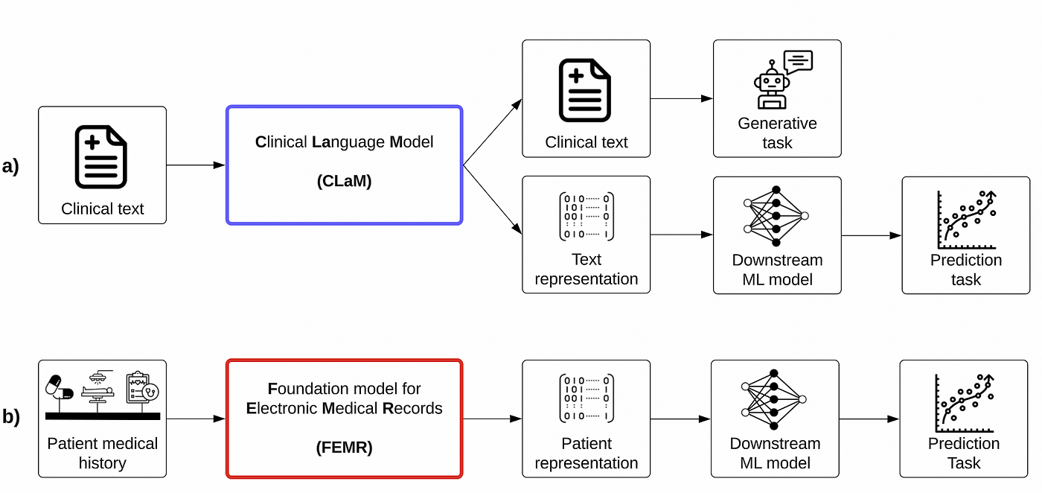
Figure 1. Overview of the inputs and outputs of the two main types of clinical FMs. (a) The inputs and outputs of CLaMs. (b) The inputs and outputs of Foundation models for FEMRs.

Slide 7
Benefits of Clinical FMs:
Clinical FMs have much better predictive performance.
Clinical FMs often require very less labeled data.
Clinical FMs enable very simpler and cheaper model deployment.
Clinical FMs are much more effective in handling multinomial data.
Clinical FMs can also handle novel interfaces for that are useful for human-AI interaction.

Slide 8
Training Data and Public Availability of models:
CLaMs
Training Data: CLaMs are trained on either clinical text or biomedical text. Almost all CLaMs trained on clinical text use a single database: MIMIC-III, which has 2 million notes written.
Model Availability: Almost all the CLaMs are publicly accessible via HuggingFace, etc.
FEMRs
Training data: Most of the FEMRs are trained mostly on small, publicly available EMR datasets or a unique private health system’s EMR database like MIMIC-III. It has less than 40,000 patients.
Model Accessibility: FEMRs lack a common process like the HuggingFace for distributing models to the research community.

Slide 9
Current Evaluation of Clinical FMs:
Clinical FMs are assessed based on the tasks are relatively very easy for evaluation. These provide very limited insight on the FMs being a “categorically different” technology.
CLaMs
We collected almost every evaluation task which a CLaM was evaluated on its previous original publication. These are evaluated based on standard tasks and standard datasets.
FEMRs
We collected the real tasks on which each FEMR was evaluated in Figure 3b. Evaluation done based on standard tasks and standard datasets. This is even worse than that of CLaMS. FEMRs lack a huge set of “canonical” evaluations. This makes it highly non feasible to compare the performance of various FEMRs.

Slide 10
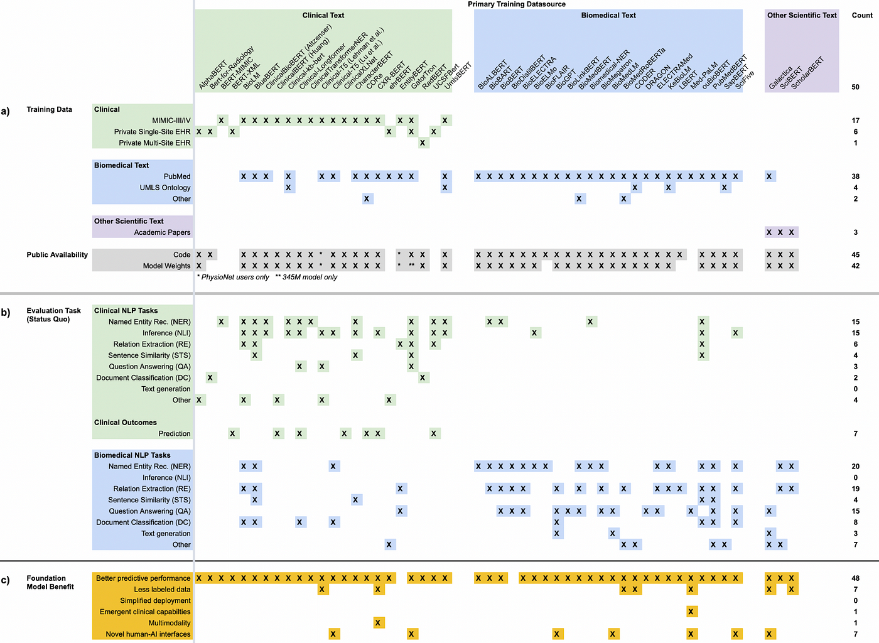
Figure 2. A depiction of CLaMs way of training, evaluation and publishing.

Slide 11
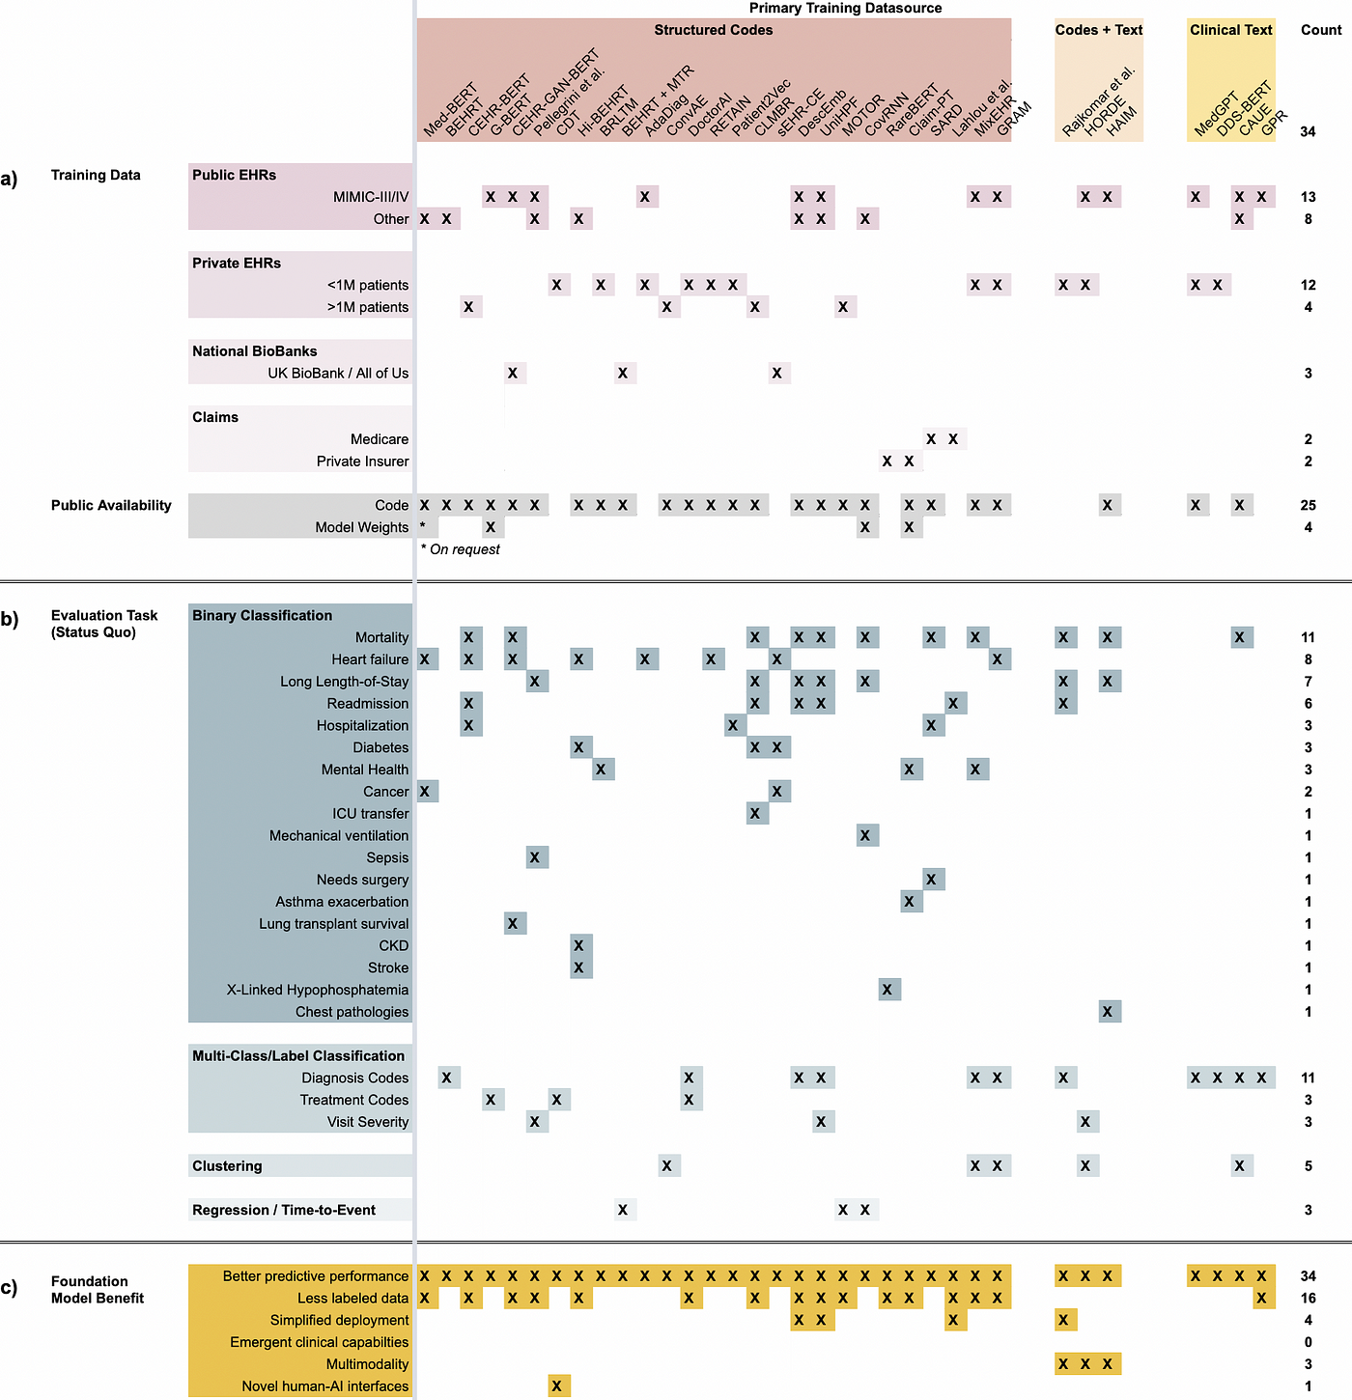
Figure 3. A Depiction of FEMRs and the way they are trained, evaluated and published.

Slide 12
Improved Evaluation Paradigms for Clinical FMs.
Better Predictive Performance.
Less Labeled Data.
Simplified Model Deployment.
Emergent Clinical Applications.
So many emergent clinical applications.
Multimodality
Novel Human-AI Interfaces.

Slide 13
Conclusion
This review of 50 CLaMs and 34 FEMRs, shows that most of the clinical FMs are being evaluated on the tasks which give very less information on the advantages of FMs over the traditional ML models. Figure2 and Figure3 show that very less work has been performed to validate if there are any other benefits of FMs.
We focused this review mostly on the benefits of clinical FMs with which we can conclude that there are various risks involved and many disadvantages which needs some attention. Similar to traditional ML models , FMs are also open to biases induced by overfitting of the datasets.
Keeping all these aside, FMs are really prominent in solving huge range of healthcare complexities.

Slide 14
Thank You
Harshavardhan Valmiki
017442984

